Slide 1


DEPARTMENT OF COMPUTER SCIENCE & ENGINEERING
SCHOOL OF COMPUTING
10214CS601 MINOR PROJECT -1
SUMMER SEMESTER(2023-2024)
SEMESTER END PROJECT VIVA VOCE EXAMINATIONS
“AUTOMATIC IRRIGATION WITH IOT MONITIRIZING SOIL MOISTURE”
SUPERVISED BY
PRESENTED BY
Dr.M.SANKAR ,ME,PhD .,
PROFESSOR
1.BHUVANESWARI S (VTU19478)(21UECS0090)
2.G RUPESH (VTU19496)(21UECB0007)
3.YAZHINI G (VTU19496)(21UECM0265)

Slide 2
OVERVIEW
ABSTRACT
OBJECTIVES
TIMELINE OF THE PROJECT
INTRODUCTION
LITERATURE REVIEW
DESIGN AND METHODOLOGIES
IMPLEMENTATION
CONCLUSION
REFERENCES

Slide 3
ABSTRACT
This Project is about Cultivation ,the main objective of project is water conservation, automated irrigation, remote monitoring and control by incorporating IOT technology.
We went through existing system ,where it has some drawbacks like inefficient water storage, labour intensive, reduced crop yielding and lack of automation in the system. So, by introducing new method of smart irrigation system which addresses the limitations of existing systems by utilizing IoT technology and soil moisture sensors for optimize the irrigation practices.
In this project ,we use soil moisture sensor, data transmission, decision-making algorithm, automated actuation and remote access to control the irrigation process. By using these technologies, we can efficiently store water,increase crop yield, reduce cost, environmental sustainability and data-driven insights .
Keywords : remote monitoring, soil moisturing sensing, smart irrigation, IOT technology, environmental sustainability .

Slide 4
OBJECTIVES
Aim of the Project:
" Automatic Irrigation With IoT Monitirizing Soil Moisture " project is to develop an innovative and efficient irrigation system that utilizes IoT technology and soil moisture sensors to optimize the irrigation process.
Scope of the Project:
The project's scope involves the development of a comprehensive and scalable smart irrigation solution that addresses the challenges of conventional irrigation systems. By focusing on water conservation, improved crop yield, and ease of use, the project aims to contribute to sustainable agriculture and environmental preservation.

Slide 5
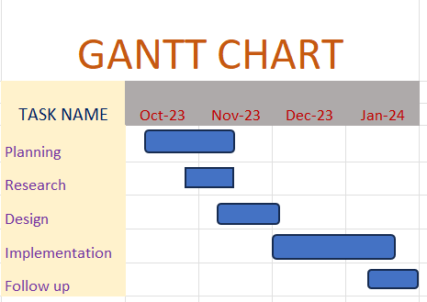
TIMELINE OF THE PROJECT
Include as GANTT CHART
Include timeline from October 2023 to January 2024.

Slide 6
INTRODUCTION
By using the concept of smart irrigation system a farmer can save water up to 75%. This concept depends on irrigation methods like conventional irrigation methods like overhead sprinklers, i.e. wet the lower leaves and stem of the plants
The IoT Technologies of water in the field is known as irrigation. Irrigation comes in many forms. Many kinds of efficient water supplying technology is replacing rapidly the old ones and applying them to the soil. Depending on how water is distributed throughout the eld there are many different types of irrigation systems.
The usage of this particular technique makes the field irrigation system & its soil monitoring system independent of human intervention, and thus the establishment of an automatic irrigation system and soil monitoring system that is known as the smart irrigation and soil monitoring system for this reason. In this project we have tried to:
1. Reduce the wastage of water in name of irrigation.
2. Reduce manual efforts in irrigation of the fields.
3. Increase the crop yielding of the field with a proper well calculated way of irrigation rather than the commonly used assumption method.

Slide 7
LITERATURE REVIEW
Author’s Name | Paper name and publication details | Year of publication | Main content of the paper
K.R.Afia | Smart irrigation system ,IEEE AFRICON | 2019 | Android based remote logging and control
R.Sudheer | Smart irrigation based on crops using IOT,IEEE 15th international conference on industrial and information systems | 2020 | It is based on purely IoT system

Slide 8
P.Pang | Rsearch on open channel irrigation decision system,IEEE international conference on intelligent transportation | 2021 | Smart irrigation based on decision making system
V.Janamala | Solar PV Tree Designed Smart irrigation,international conference of smart and sustainable technologies in energy in power sectors | 2022 | Survive the agriculture in effective methodology

Slide 9
Soil Properties
Soil Structure. Soil structure refers to the arrangement of soil particles (sand, silt, and clay) into stable units called aggregates (known to soil scientists as peds)
Soil Texture
Soil Porosity
Soil Colour
Soil Permeability
Bulk Density
Soil pH
Buffer pH

Slide 10
DESIGN AND METHODOLOGIES
Hardware used:
Arduino UNO
Soil Moisture Sensor
Breadboard
Connector wires
Relay module
Mini submersible pump and Water Tank
LCD Display MODULE
ArduinoDroid application for coding of Arduino UNO
Power Supply(Battery)
Here we use Soil moisture sensor that senses the moisture content of the soil and send the information to the Arduino UNO (Microcontroller).
By use of ArduinoDroid we implement the code for Arduino software that takes the decision to serve water to the land through relay module and water pump from water tank.
And further to display the Moisture level and Water pump status(On or Off) Lcd display is connected with Arduino and Relay module.
Our project is fully Automated, it reduces Labour intensive and increase in Water conservation.

Slide 11
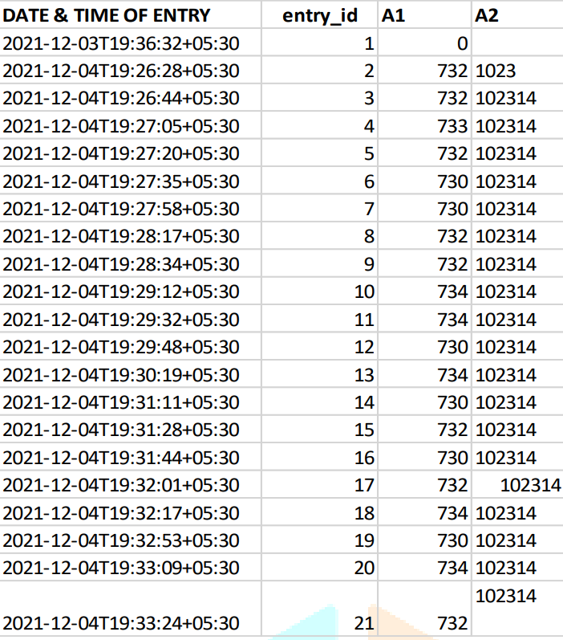
MODULE 1:SAMPLE DATASHEET
Step:1 Collection of data

Slide 12
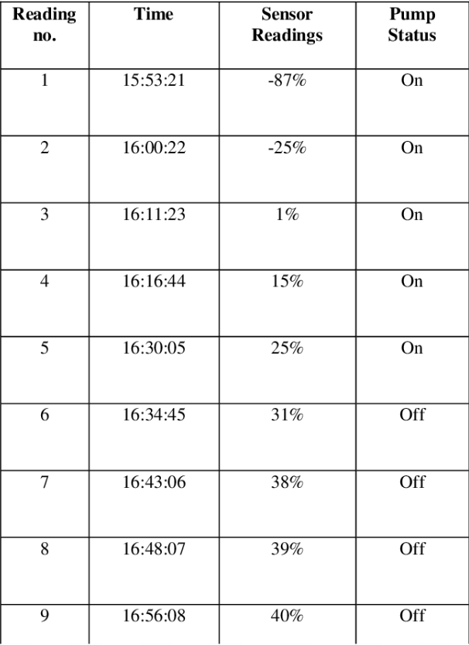
Step 2: Processing the data

Slide 13
Module 2- Mention the algorithm
In our project, We use Arduino Droid software to develop the code for Arduino UNO which takes the information from the moisture sensor and transmit to the pump to Relay module.
Arduino take the moisture content from soil through soil moisture sensor and send the data to Arduino UNO.
Installed a software Arduino Droid ,to write and execute the code written .
Through that code Arduino UNO takes decision and pass information information to Relay module
(to switch ON or OFF the pump).
If moisture content is low , switch ON the waterpump which serve the water to crops.
If moisture content is high , switch OFF the waterpump
To make decision codes are used in software and runs automatically

Slide 14
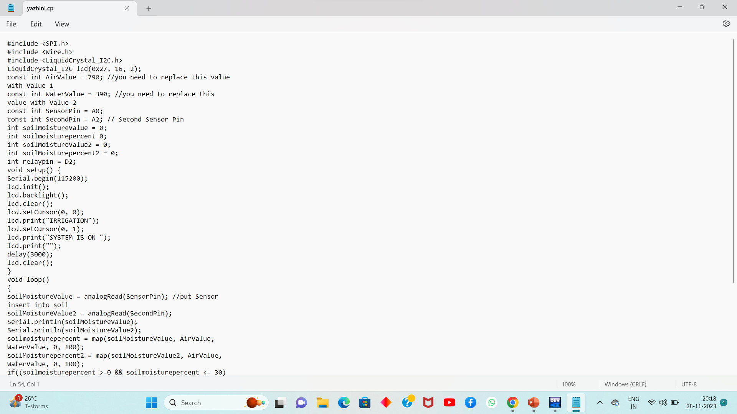
Step 3: Using algorithm’s decision making algorithm

Slide 15
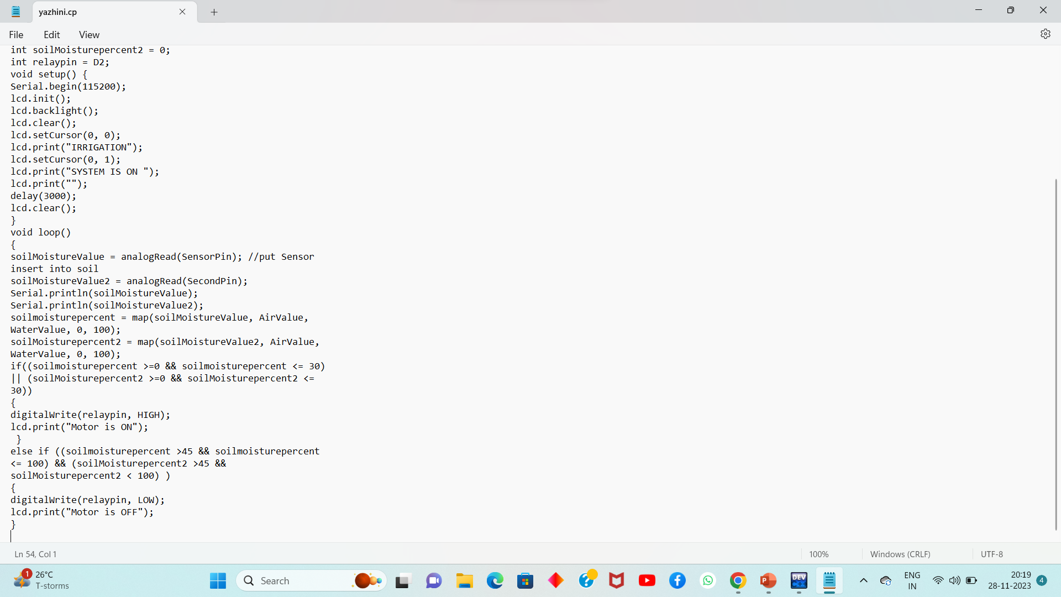

Slide 16
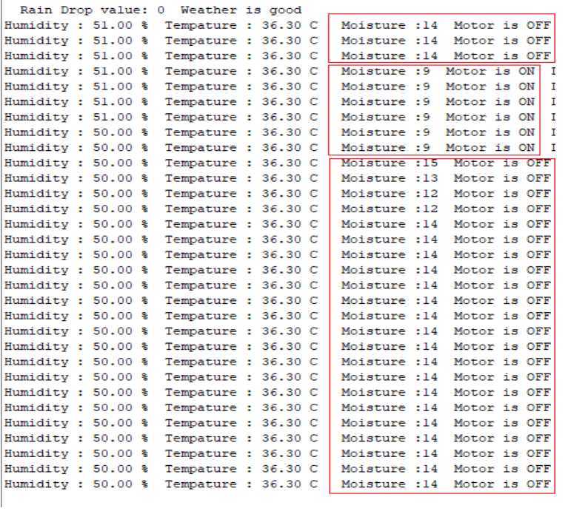
Step 4: The output

Slide 17
IMPLEMENTATION
Architecture Diagram
Data –Flow Diagram
Use Case Diagram
Class Diagram
Activity Diagram
Sequence Diagram
E-R Diagram

Slide 18
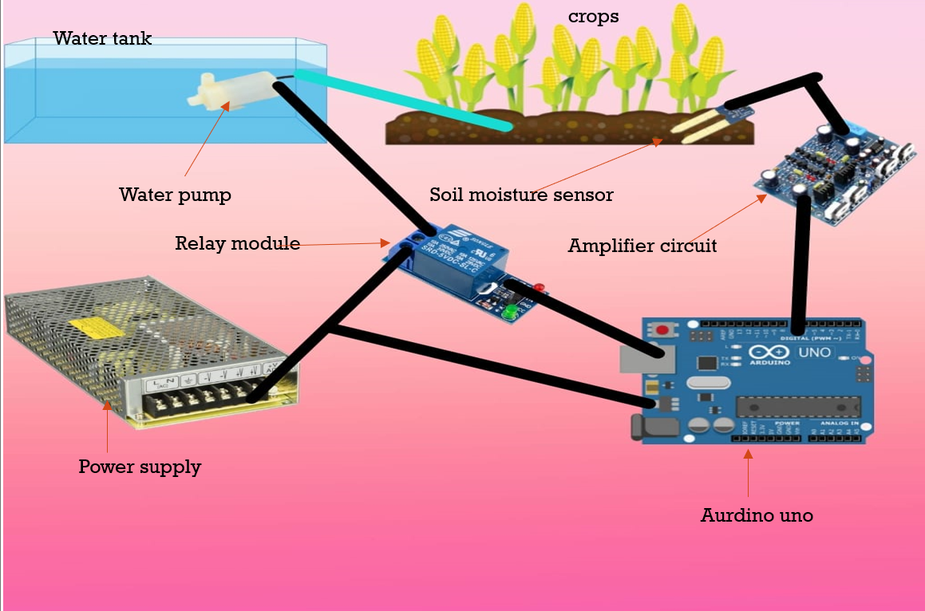
Architecture Diagram
Soil moisture sensor that senses the moisture content of the soil and send the information to the Arduino UNO (Microcontroller).
By use of ArduinoDroid we implement the code for Arduino software that takes the decision to serve water to the land through relay module and water pump from water tank.
And further to display the Moisture level and Water pump status(On or Off) Lcd display is connected with Arduino and Relay module.

Slide 19
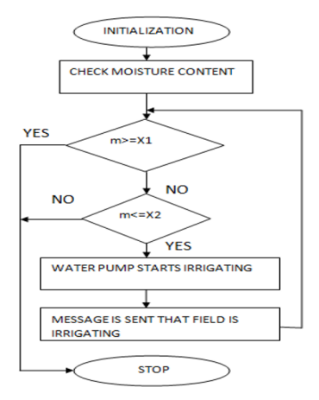
Data –Flow Diagram
Start
Check the moisture content.
If moisture content is greater,STOP.
Else water pump start irrigating in crops.
Stop

Slide 20
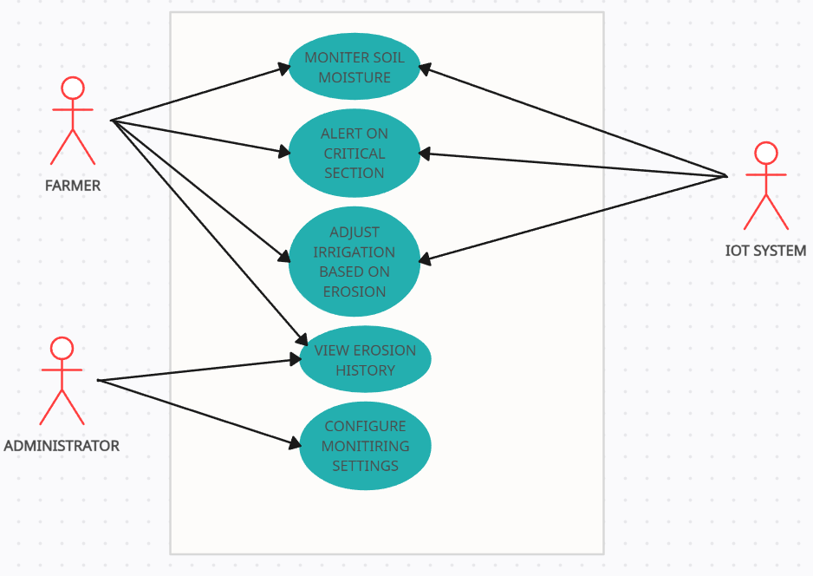
Use Case Diagram

Slide 21
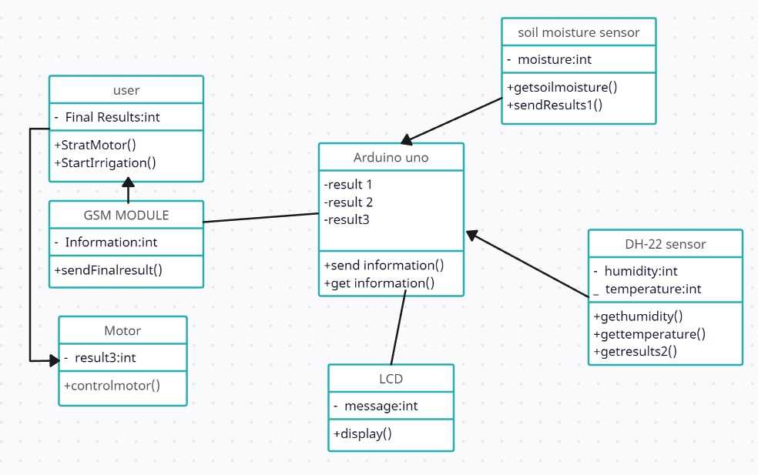
Class Diagram

Slide 22
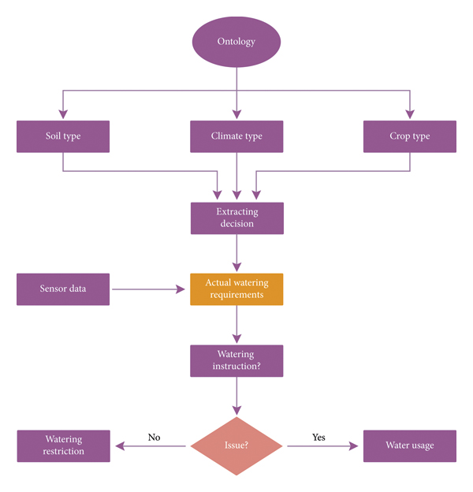
Activity Diagram

Slide 23
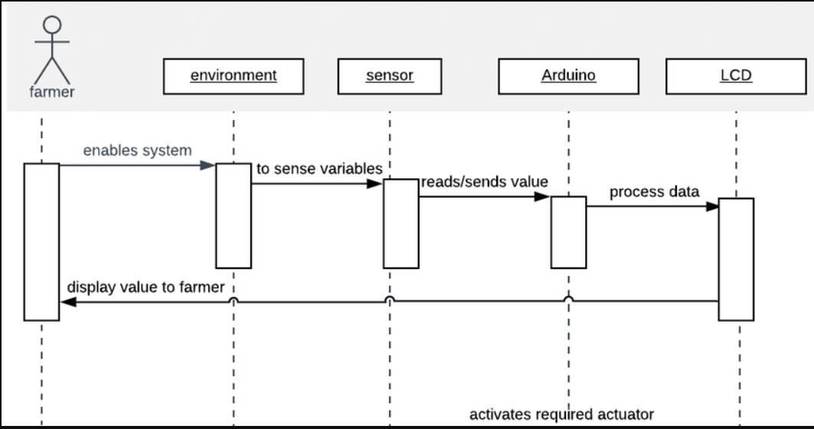
Sequence Diagram

Slide 24
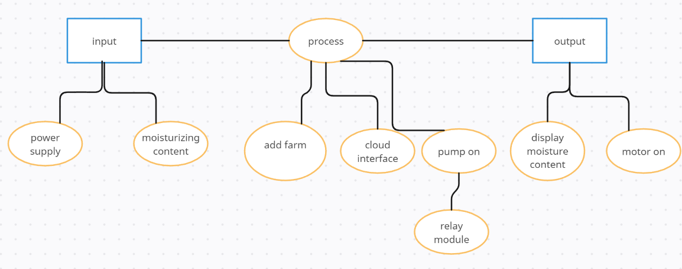
E-R Diagram

Slide 25
TESTING
UNIT TESTING
INTEGRATION TESTING
FUNCTIONAL TESTING
WHITE BOX TESTING
BLACK BOX TESTING

Slide 26
UNIT TESTING
Sensor Unit Tests: Ensure that each soil moisture sensor provides accurate readings. Mock or simulate sensor data to test how the system responds to different moisture levels.
Microcontroller Unit Tests: Test the individual functions of the microcontroller responsible for collecting and processing sensor data. Mock inputs and outputs to simulate different scenarios.
INTEGRATION TESTING
Sensor Integration Tests: Verify that the communication between sensors and microcontrollers is reliable. Check how the system handles multiple sensors providing data simultaneously.
Microcontroller-Communication Module Integration Tests: Ensure that the communication module (e.g., Wi-Fi, Bluetooth) effectively transmits data from the microcontroller to the central monitoring system

Slide 27
SYSTEM TESTING
End-to-End Tests: Test the entire system, including multiple sensors, microcontrollers, and communication modules. Validate that the data reaches the central monitoring system accurately.
Communication Reliability Tests: Simulate scenarios where network connectivity is poor or temporarily lost. Ensure the system can recover and synchronize data when the connection is restored.
FUNCTIONAL TESTING
Moisture Level Control Tests: Verify that the irrigation system responds appropriately to the soil moisture levels. Test different irrigation scenarios based on moisture thresholds.
Alerts and Notifications Testing: Ensure that the system triggers alerts or notifications when moisture levels deviate from the predefined thresholds.

Slide 28
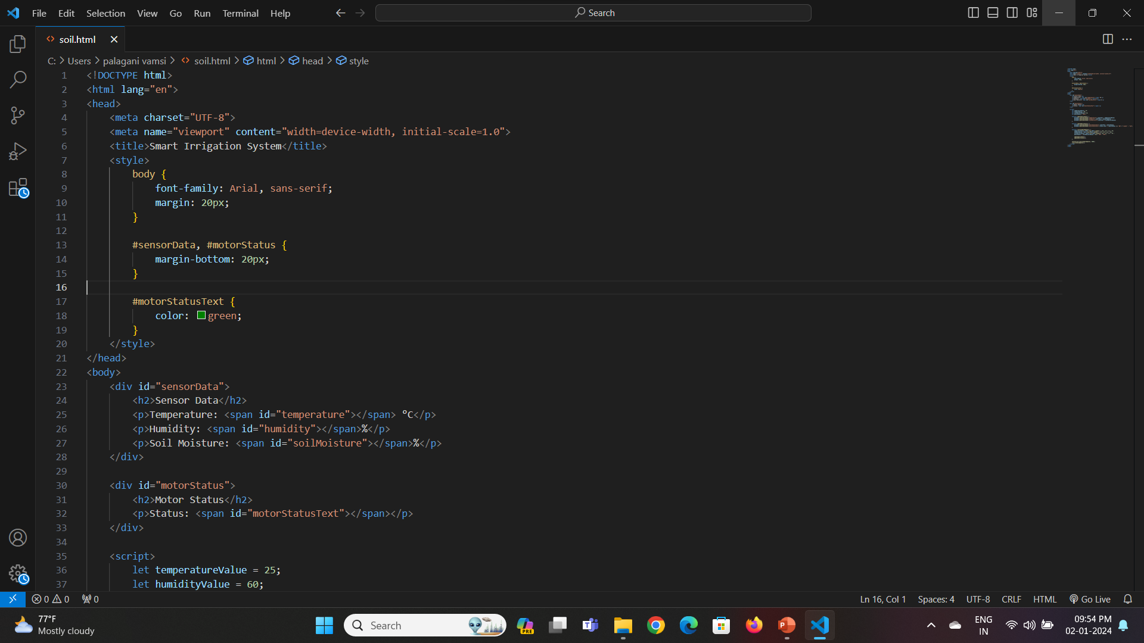
SOURCE CODE

Slide 29
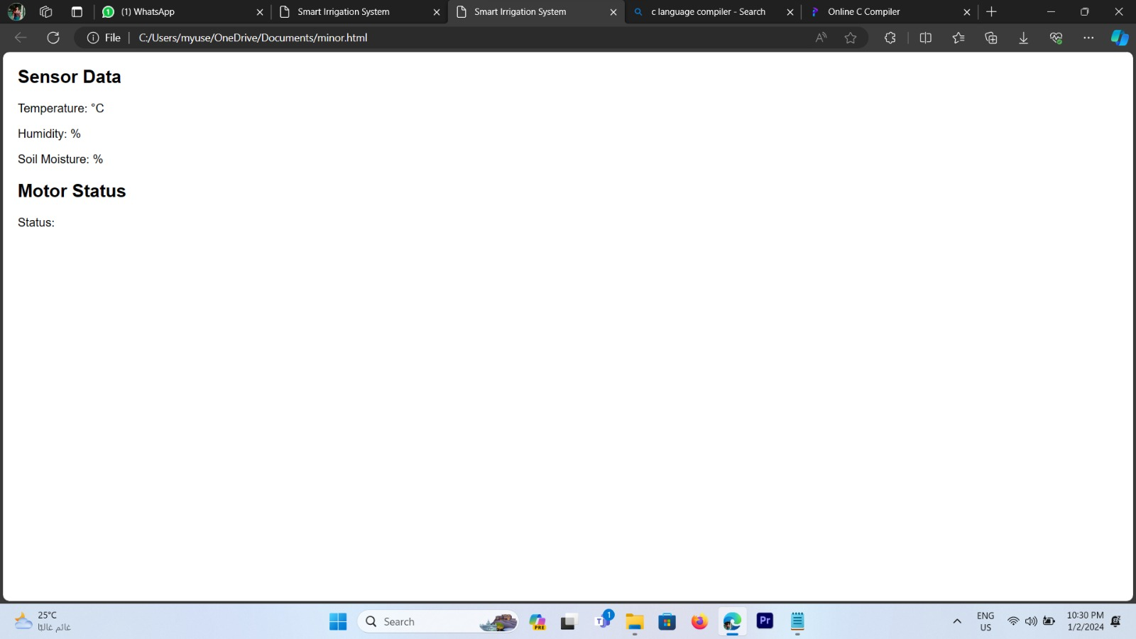
OUTPUT

Slide 30
CONCLUSION
An automatic check gate has been developed for the basin and connected to IoT through the wireless soil moisture sensor network using GSM with the aim that farmers/users can operate the gate opening and closing remotely with minimum manual interventions.
Farmer can get the real-time moisture status of the field remotely and can make a decision of irrigation start and end on the basic real-time moisture status. The system was successfully tested in bare loamy soil. The study also attempted to identify the suitable location and number of sensors in the field to increase irrigation application efficiency.
Three operational schedules based on a different combination of depth and length along the flow had been evaluated, which indicated that at least two soil moisture sensors are required for the efficient operation of the system.
One for the opening which is at 15 cm depth and 50% length of the field and another for closing the system. The best location of the sensor for closing the system would be at 37.5 cm depth placed at 25% length from the inlet in higher soil moisture deficit condition and at 7.5 cm depth placed at 75% length in low moisture deficit condition. It indicated that the location of the sensor for closing the system depends upon the soil moisture depletion. Overall, the average application efficiency had been improved up to 86.6% through automation.

Slide 31
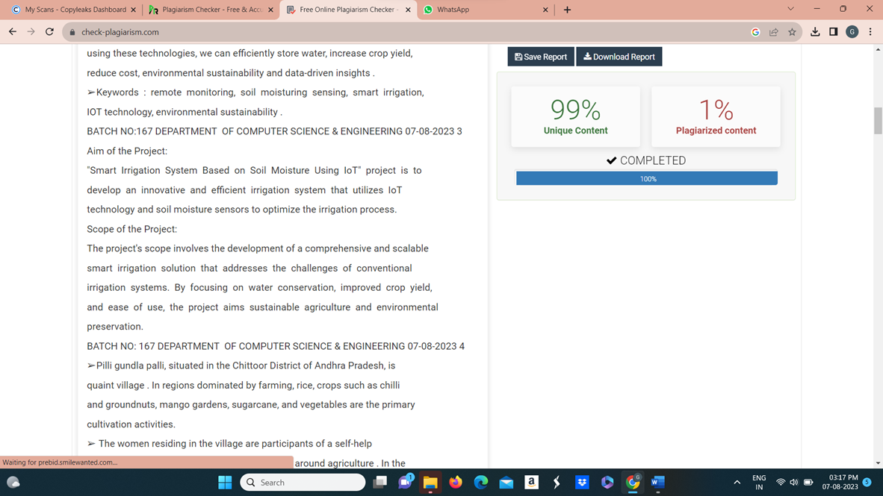
Plagiarism Report of PPT

Slide 32
Web references/video links
https://www.researchgate.net/publication/357748563_THE_SMART_IRRIGATION_SYSTEM_USING_IOT
https://circuitdigest.com/microcontroller-projects/iot-based-smart-irrigation-system-using-esp8266-and-soil-moisture-sensor
https://www.sciencedirect.com/science/article/pii/S2772375521000320
https://youtube.com/shorts/aPPB42QpzVo?si=yFXSIzdKxqhLz5Oc
https://youtube.com/shorts/5scMCeQZv-4?si=DEh-hGaTKpMT2xTM

Slide 33
REFERENCES
As per IEEE format,
O. K. Ogidan and K. R. Afia, "Smart irrigation system with an Android-based remote logging and control," 2019 IEEE AFRICON, Accra, Ghana, 2019, pp. 1-4, doi: 10.1109/AFRICON46755.2019.9133953.
S. Peraka, R. Sudheer, B. N. Rao, A. R. Teja and E. N. Kumar, "Smart Irrigation based on Crops using IoT," 2020 IEEE 15th International Conference on Industrial and Information Systems (ICIIS), RUPNAGAR, India, 2020, pp. 611-616, doi: 10.1109/ICIIS51140.2020.9342736.
H. -B. Zhang, J. -M. Li, R. Huang, P. Pang and Y. Zheng, "Research on open channel irrigation decision system under the background of smart agriculture," 2021 International Conference on Intelligent Transportation, Big Data & Smart City (ICITBS), Xi'an, China, 2021, pp. 594-597, doi: 10.1109/ICITBS53129.2021.00151.
K. K. U and V. Janamala, "Solar PV Tree Designed Smart Irrigation to Survive the Agriculture in Effective Methodology," 2022 International Conference on Smart and Sustainable Technologies in Energy and Power Sectors (SSTEPS), Mahendragarh, India, 2022, pp. 1-6, doi: 10.1109/SSTEPS57475.2022.00016.
R. Vijay, Y. V. Priya, P. C. Reddy, S. Monisha and V. Ramasamy, "A IoT based Smart Auto Irrigation system," 2023 International Conference on Computer Communication and Informatics (ICCCI), Coimbatore, India, 2023, pp. 1-4, doi: 10.1109/ICCCI56745.2023.10128325.

Slide 34
THANK YOU

